Slide 1
IN THE NAME OF GOD

Slide 2
TEXT MINING
CLUSTERING AND INFORMATION RETRIEVAL
.
INSTRUCTOR : DR.Gamasaee
BY:
Kamyar vafayinejad
Mahdi Haghbayan

Slide 3
TEXT MINING
Information retrieval & search engines
Clustering

Slide 4
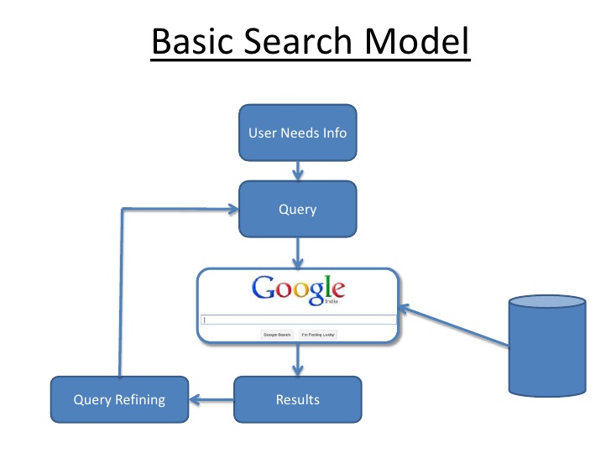

Information retrieval &
search engines

Slide 5
Information retrieval &
search engines
Extract vocabulary and removing duplicates
Calculating frequency of query and document
Choosing best document related to query
Entering word of query separating
Splitting word of document
1
2
3
4
5

Slide 6
data mining is a rather new field of study for discovering knowledge from data. this data can be numeric data or even a text, so data mining is of paramount importance.
text mining system makes an exchange of words from unstructured data into numerical values.
text mining also referred to as text data mining, roughly equivalent to text analytics, is the process of deriving high-quality information from text.
1.{‘data','mining','text‘}
2.{'unstructured','mining','text‘}
Document 1
Document 2
Document 3
query

Slide 7
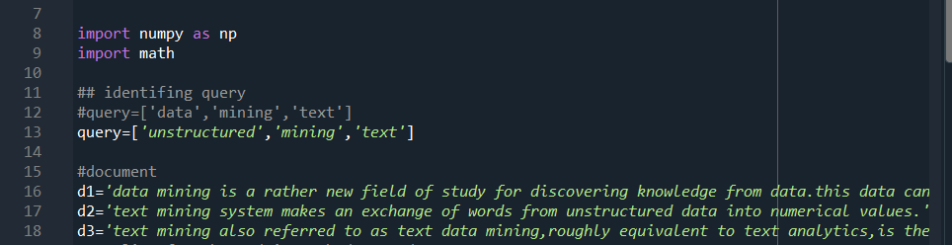
Entering query
vocabulary
Splitting word of document
Algorithm
Choosing best document related to document

Slide 8
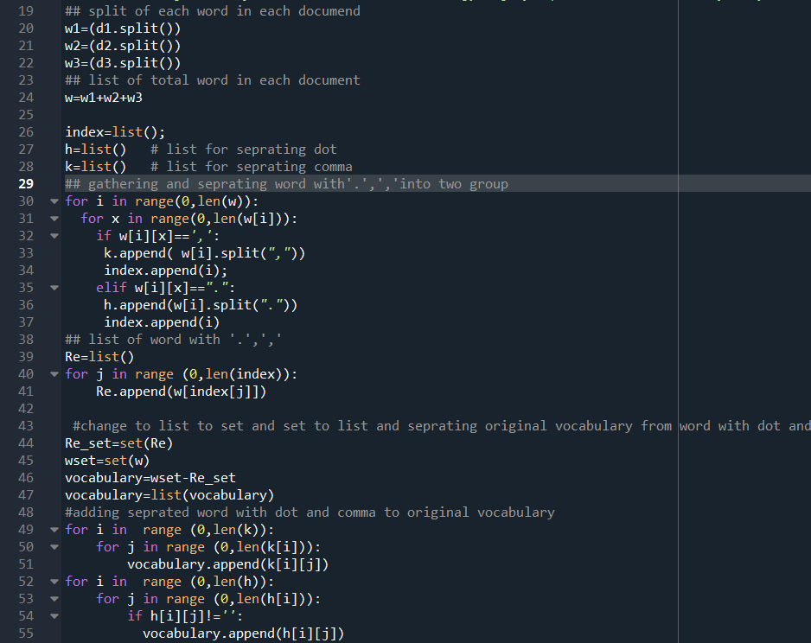
Entering query
Separating word from comma and dot
vocabulary
Splitting word of document
Algorithm
Choosing best document related to document
Adding separated word from comma and dot

Slide 9
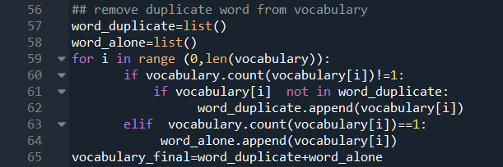
Remove duplicate word from vocabulary
Entering query
vocabulary
Splitting word of document
Algorithm
Choosing best document related to document

Slide 10
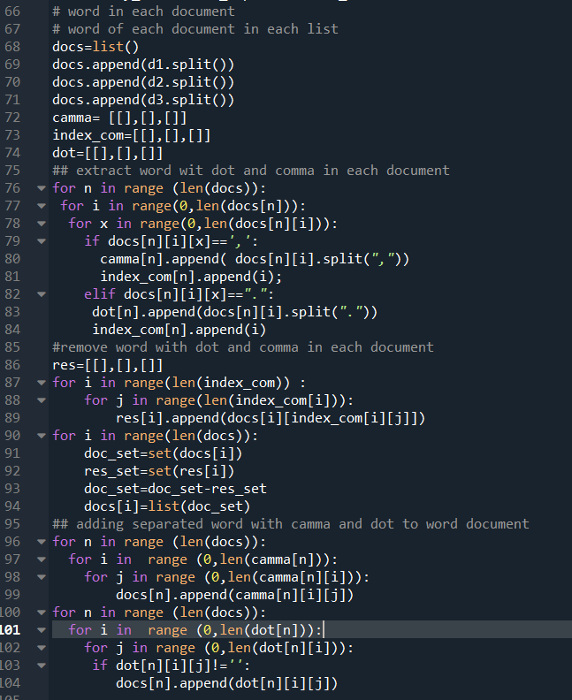
Entering query
vocabulary
Splitting word of document
Algorithm
Choosing best document related to document

Slide 11
Entering query
vocabulary
MAIN TITLE
Splitting word of document
TOTAL
TDF
Algorithm
Freq(w,d)
Choosing best document related to document
Freq(q,d)

Slide 12
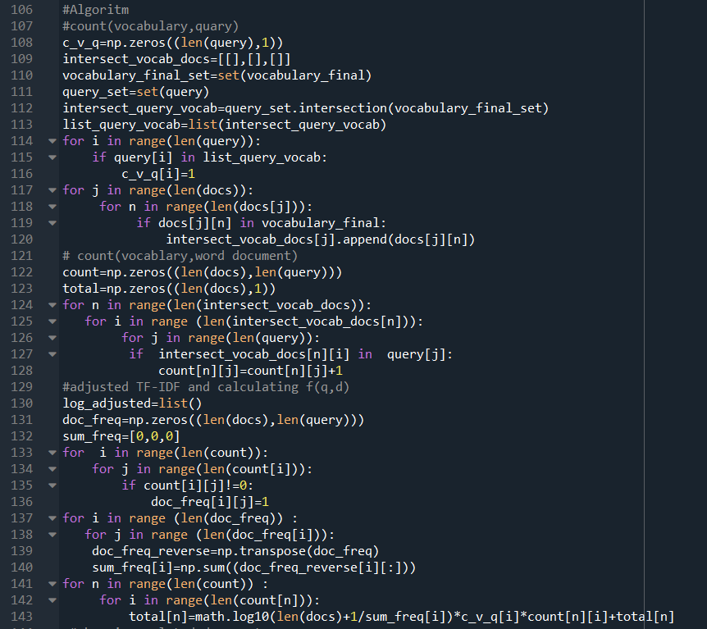
Freq(q,w)
Entering query
Freq(d,w)
vocabulary
Splitting word of document
Algorithm
TDF
Choosing best document related to document

Slide 13
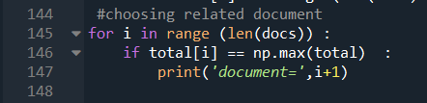
Entering query
vocabulary
Splitting word of document
Algorithm
Document=3
Choosing best document related to document

Slide 14
CLUSTERING

Slide 15
Steps required for preparing docs for clustering
01
Docs
04
Counting
3 paragraphs has been written here
The repetition of words in all docs must be found
02
Splitting Words
05
Finding Vocab Library
Some punctuations split words
1. Comma 2.space 3.period
A library that contains all of words used in docs is needed
03
Removing Duplicates
Some words are used more than one time

Slide 16
DOCS
data mining is a rather new field of study for discovering knowledge from data.this data can be numeric data or even a text,so data mining is of paramount importance.
all people have access to a computer.computer was devised about 50 years ago by some American scientists.since then,it has affected all parts of our lives.
physical activities helps all people to remain healthy.another way they have for remaining healthy is eating food which is healthy.
data mining is a rather new field of study.this data can be numeric data or even a text,so data mining is importance.
DATA MINING
HEALTH
COMPUTER
DATA MINING
31 words
21 words
28 words
A part of first paragraph
For testing

Slide 17
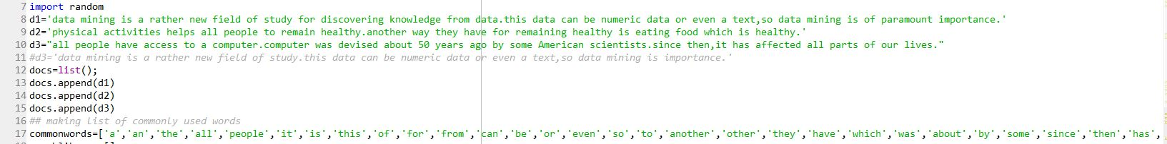
DOCS
DATA MINING
HEALTH
COMPUTER
DATA MINING
31 words
21 words
28 words
A part of first paragraph
For testing

Slide 18
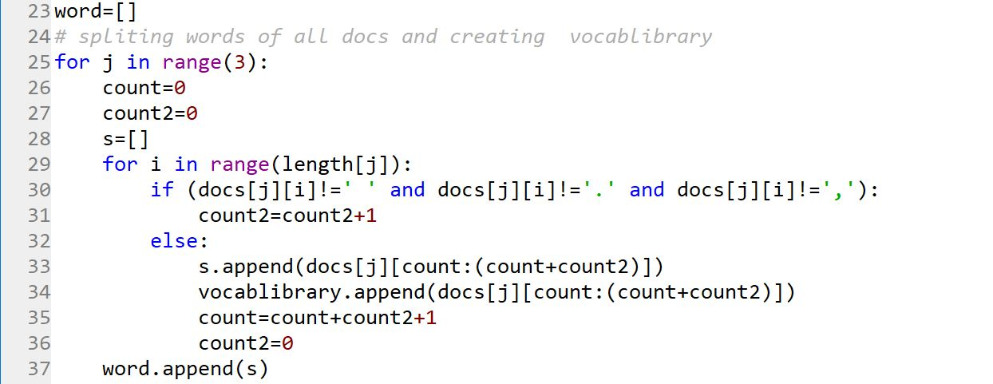
The first and last letter of each word is determined with these variables

Slide 19
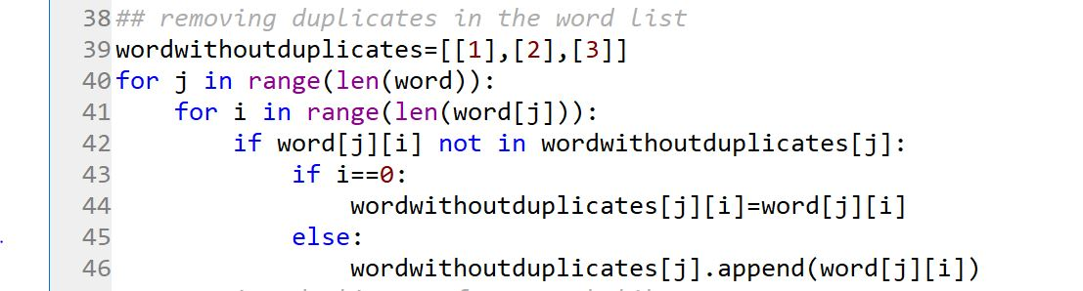

Slide 20
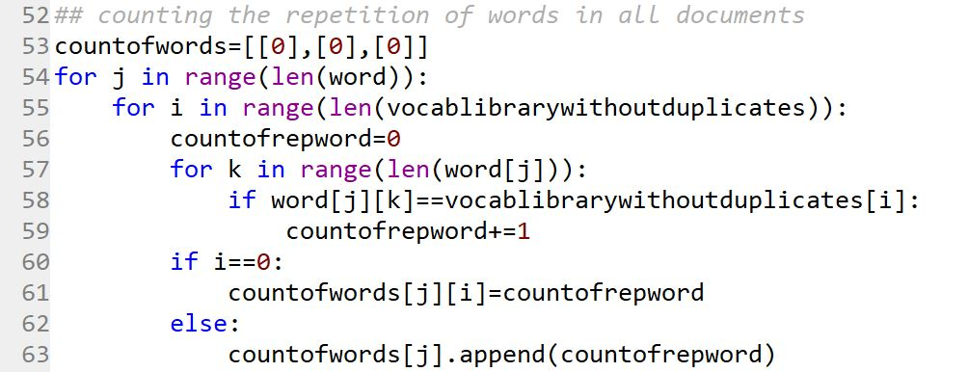

Slide 21
Initialization
Determining P(W|ϴ) arbitrarily
Starting main loop
Determining the probability that each cluster is chosen
P(ϴ)
The number of clusters ( for our example, it is 2)

Slide 22
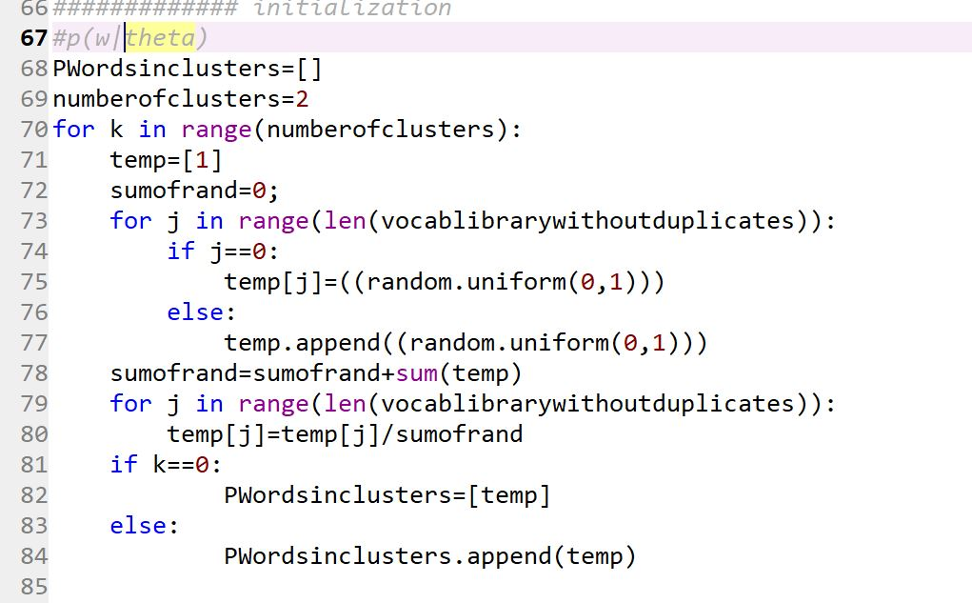
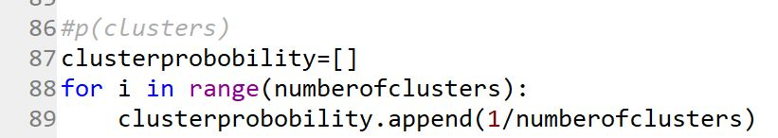

Slide 23
LOOP
1
FINDING MEMBERSHIP
The probability that a cluster contains a document
2
FINDING CLUSTERS PROBOBILITY
The probability that a cluster is chosen will be calculated
3
Determining P(W|ϴ)
4
OBTAINIING THE VALUE OF OBJECTIVE FUNCTION
The value of maximum likelihood(objective function) is calculated

Slide 24
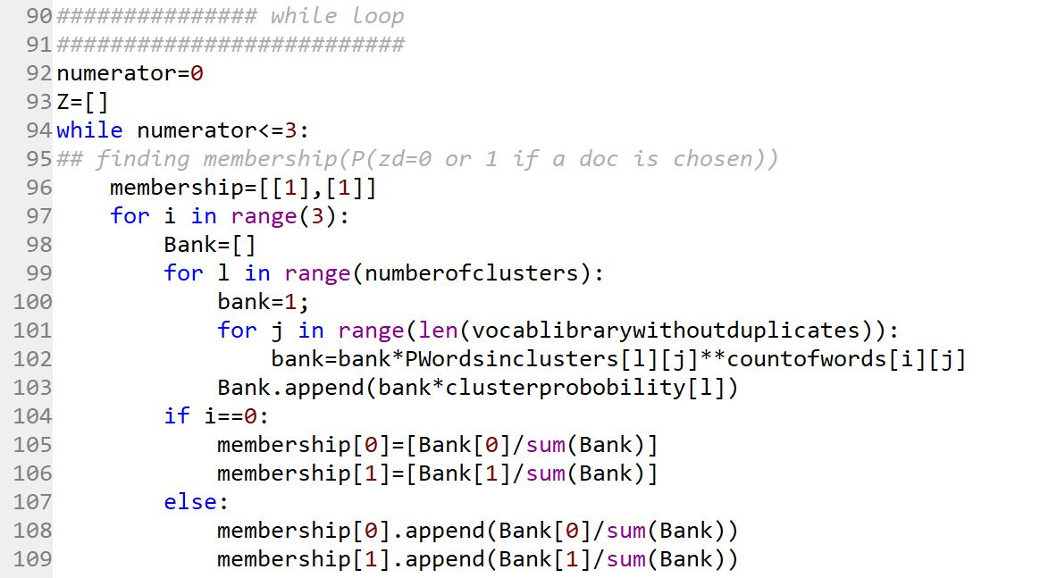
1

Slide 25
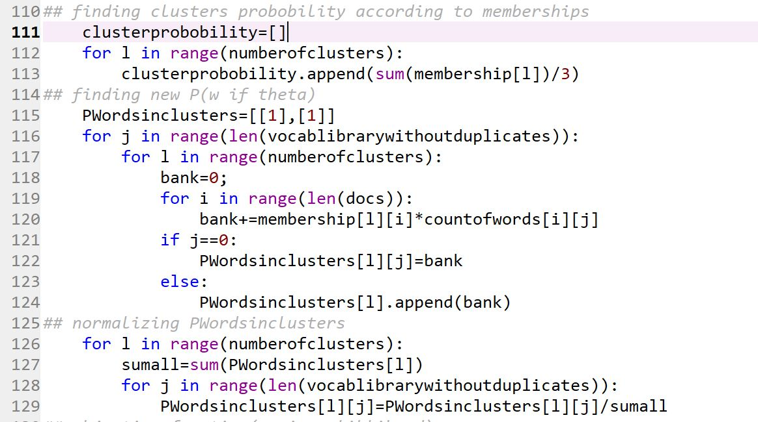
2
3

Slide 26
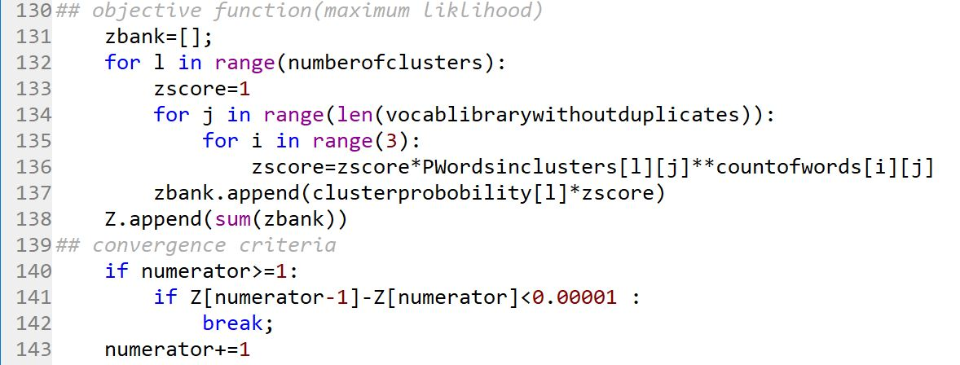
4

Slide 27


